Slide 1
Price Recommendation System
For Hospitality Sector
Mini Project Presentation: Zeroth Review
Presented By
Guided By
HASHIF V.S
SJC20AD036
Ms.Neena Joseph
Assistant Professor
Artificial Intelligence and Data Science Department
JAIDON GILL SHAJAN
SJC20AD039
JOMAL P JOY
SJC20AD043
PRIYAN V
SJC20AD050

Slide 2
OUTLINE
Introduction
Motivation
Literature Survey
Existing Systems
Proposed System
Objectives
Methodology
Data Description
Future scope
Conclusion
References

Slide 3
Introduction
We propose a price recommendation system for hospitality sector which is an innovative system that takes into account a variety of factors to predict the optimal price for hotel rooms, allowing hotel managers to make informed pricing decisions and stay competitive in the ever-changing market.
The system targets hotel business owners.
We will explore the various components of the room price recommendation system, including its use of live market pricing data and machine learning algorithms to provide real-time recommendations.
This system makes use of a dynamic pricing strategy known as competitive-based pricing which focuses on monitoring competitor prices across different channels.

Slide 4
Motivation
The hospitality industry is highly competitive, with hotels constantly striving to attract guests while maximizing their profits.
Traditional pricing strategies, however, often lack the sophistication needed to take into account all the relevant factors that affect pricing decisions.
This is where the room price recommendation system comes in, providing a data-driven approach to optimize room pricing decisions.
The existing systems have proven to be efficient over traditional strategies
One recent example of a successful hotel room price recommendation system is the one implemented by Marriott International. According to a press release by Marriott, the OptimizeRM system has already generated significant revenue gains for the company. In a pilot program conducted at 20 Marriott properties, the system was able to increase revenue per available room (RevPAR) by up to 10% in some cases.
​

Slide 5
Existing Systems
OptimizeRM: OptimizeRM is a revenue management system launched by Marriott International in 2021. The system uses machine learning and advanced analytics to make pricing decisions for hotel rooms based on factors such as demand, booking patterns, and market conditions.
IDeaS: IDeaS is a revenue management system that uses predictive analytics to optimize hotel room pricing. The system takes into account various factors, such as historical data, market demand, and competitor rates, to generate pricing recommendations that maximize revenue and occupancy rates.

Slide 6
Literature Review
Table1.0: Literature review
SL.No | PAPER TITLE | METHODOLOGY | ADVANTAGES | DISADVANTAGES
1 | Text-Based Price Recommendation System for Online Rental Houses -Lujia Shen, Qianjun Liu, Gong Chen, and Shouling Ji,Journal: IEEE Access,Volume: 8,2020 | Uses natural language processing; sentence embedding; Long Short-Term Memory (LSTM); mean shift | High Accuracy Real-time Price Recommendations Personalized Recommendations Cost-Effective | Limited Input Data Subjectivity of textual description limited applications
2 | Hotel room price recommendation based on gradient boosting decision tree. Journal of Ambient Intelligence and Humanized Computing, Gao, J., Tan, J., Zhang, X., & Zhou, L,12(5), 4685-4693(2021) | Uses gradient boosting decision tree (GBDT) algorithm | Accurate predictions Efficient processing Interpretable model Real-world application | Lack of comparison with other models Lack of consideration of dynamic pricing

Slide 7
3 | A Novel Dynamic Pricing Approach for Resource Allocation in Cloud Computing-Islam, M. M., Islam, M. R., & Haque, M. M. In 2021 3rd International Conference on Computer, Communication, and Cyber Security (IC4S) (pp. 1-5). IEEE. | Uses a combination of game theory, machine learning, and optimization techniques. K-means clustering and linear regression he models | Efficient resource allocation Adaptive pricing Improved user experience | Limitations in scalability and efficiency Does not provide a comprehensive evaluation of the proposed model's effectiveness and robustness in real-world scenarios
4 | Dynamic Pricing in a Competitive Environment with Strategic Customers. Management Science, Chen, Y., & Talebi, R. ,67(5), 3045-3062(2021) | The authors use a Markov decision process (MDP) to model. Uses game theory | Incorporates customer strategic behavior into the pricing model Offers a framework that can be applied to various industries. | Assumptions of complete information: The model assumes that both firms have complete information about the market and customers.

Slide 8
Proposed System
A dynamic price recommendation system that aims at hotel business owners which is non discriminant towards the scale of the business.
Data is collected dynamically from websites with the help of web scraping tools such as BeautifulSoup from Python.
Takes into consideration data such as room type, location, occupancy and listing price.
Location, occupancy, room type and the profit margin threshold prices are the inputs we require from the user.

Slide 9
Proposed System
An optimal price is predicted by the model between these threshold values and it also considers the occupancy of the hotel and varies the predicted price according to the demand.
An appropriate model from the linear family is chosen instead of fixing an exact model to use right from the start.
For this we make use of a python library PyCaret to select an optimal model that best fits our training data from a wide range of regression models
By comparing the various error metrics, we can finally choose the best linear model.
Price gets dynamically recommended on a daily basis.

Slide 10
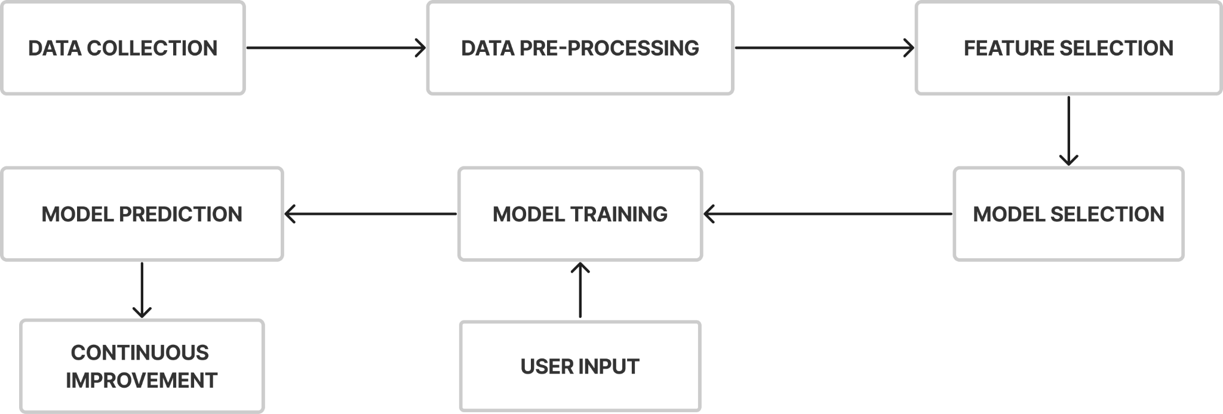
METHODOLOGY
Fig1.0:Price recommendation system methodology diagram

Slide 11
Objectives
Develop a hotel room price recommendation system using machine learning algorithms that can assist hotel revenue managers in making informed pricing decisions.
Develop a system which is dynamic in nature not by just the data collection methods but also the way in which models are implemented.
Provides a user friendly interface.
Unlike existing systems develop an open-source system that can be accessed by any business owner in the hospitality sector free of cost.

Slide 12
Data Description
We currently use competitor pricing data that can be collected dynamically by web scraping techniques across different websites.
Competitor Pricing: This data includes pricing information for competing hotels in the area. This data is used to understand the market demand and to provide pricing recommendations that are competitive with other hotels in the area.
Among several web scraping strategies, we plan to make use of Beautiful Soup library from Python.
Other relevant data: These include data such as location and type of room.

Slide 13
Future Scope
Integration with more data sources
Personalized pricing
Incorporating more relevant features
Enhanced predictive modeling
Mobile application

Slide 14
Conclusion
The hotel room price recommendation system is an innovative solution that can help hotels make informed pricing decisions and optimize their revenue and occupancy rates.
By using machine learning algorithms and analyzing large amounts of data related to market demand, competitor pricing, and other relevant factors, the system can provide real-time pricing recommendations that are accurate and up-to-date.
Its user-friendly interface allows revenue managers to easily access pricing recommendations and make informed decisions.
Contrary to existing systems we propose to develop an open source platform.
The ultimate goal of this system is to help hotels increase their profitability and competitiveness, and to improve the overall guest experience.

Slide 15
References
Text-Based Price Recommendation System for Online Rental Houses -Lujia Shen, Qianjun Liu, Gong Chen, and Shouling Ji,Journal: IEEE Access,Volume: 8,Pages: 121085-121095, 2020
Hotel room price recommendation based on gradient boosting decision tree. Journal of Ambient Intelligence and Humanized Computing, Gao, J., Tan, J., Zhang, X., & Zhou, L,12(5), 4685-4693(2021)
A Novel Dynamic Pricing Approach for Resource Allocation in Cloud Computing-Islam, M. M., Islam, M. R., & Haque, M. M. In 2021 3rd International Conference on Computer, Communication, and Cyber Security (IC4S) (pp. 1-5). IEEE.
Dynamic Pricing in a Competitive Environment with Strategic Customers. Management Science, Chen, Y., & Talebi, R. ,67(5), 3045-3062(2021)
Gao, J., Tan, J., Zhang, X., & Zhou, L. (2021). Hotel room price recommendation based on gradient boosting decision tree. International Journal of Emerging Technologies in Learning, 16(8), 226-236.
Price Recommendation System Modeling Using PyCaret and Deep Learning by Albers Uzila, article published on medium.2022
“Marriott International Increases Revenue by Implementing a Group Pricing Optimizer”-newspaper report published by informs journal

Slide 16
QUESTIONS?
15 March,2023
Mini Project (ADD-334) : Zeroth Review
16

Slide 17
THANK YOU
15 March,2023
Mini Project (ADD-334) : Zeroth Review
17

